Slide 1

Team MendIT
Review walkthrough 4
Implementation and results

Slide 2
Important tasks since last review 2
April last week-May 1
Frontend and GUI designing. testing it at the same time.
May 2- May 8
Frontend connectivity with backend, ML algorithm implementation and security feature integration.
May 10-May 20
Testing modules and generation of test report, working on terms and conditions of portal and company.

Slide 3
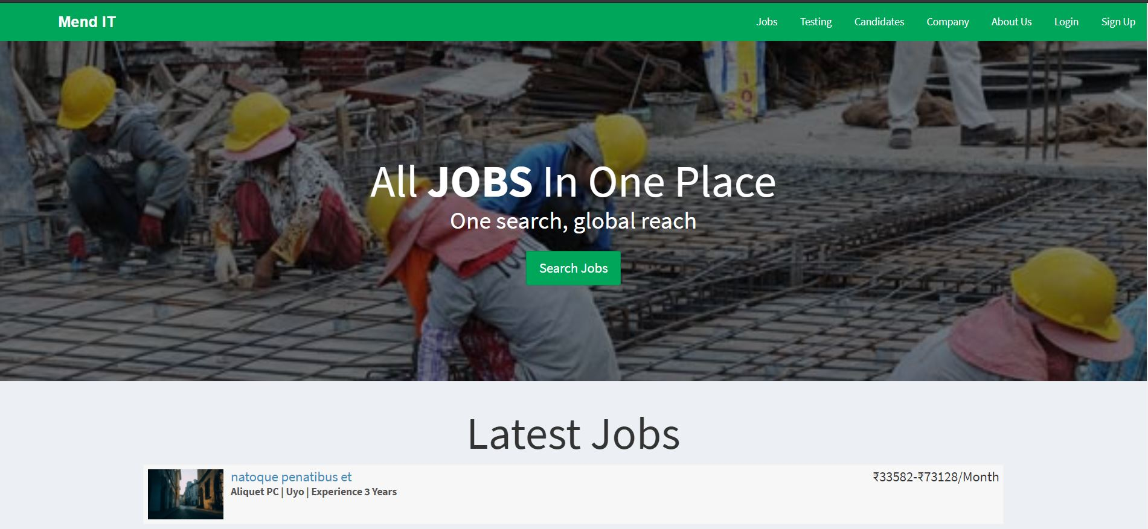
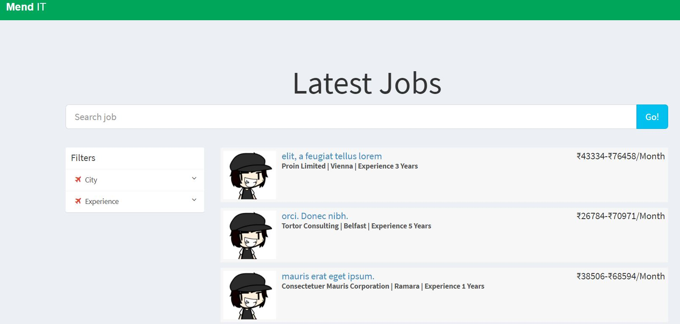
Frontend implementation

Slide 4
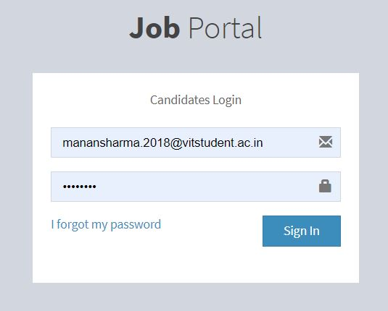
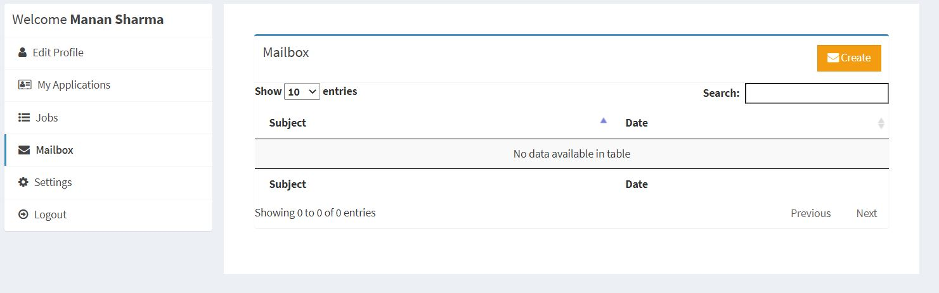
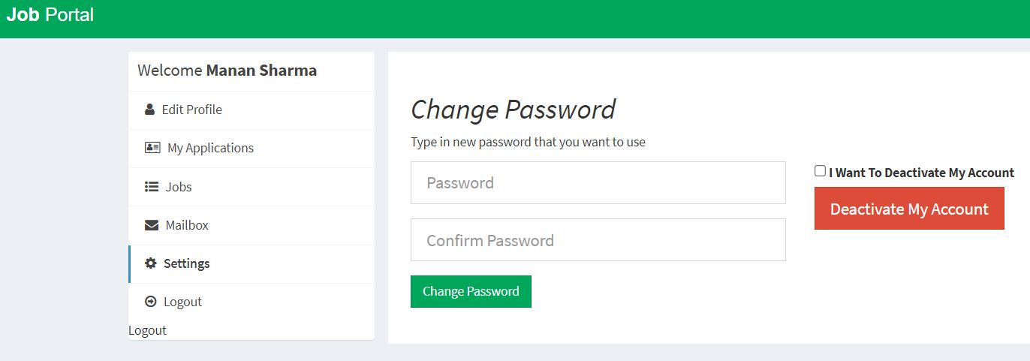

Slide 5
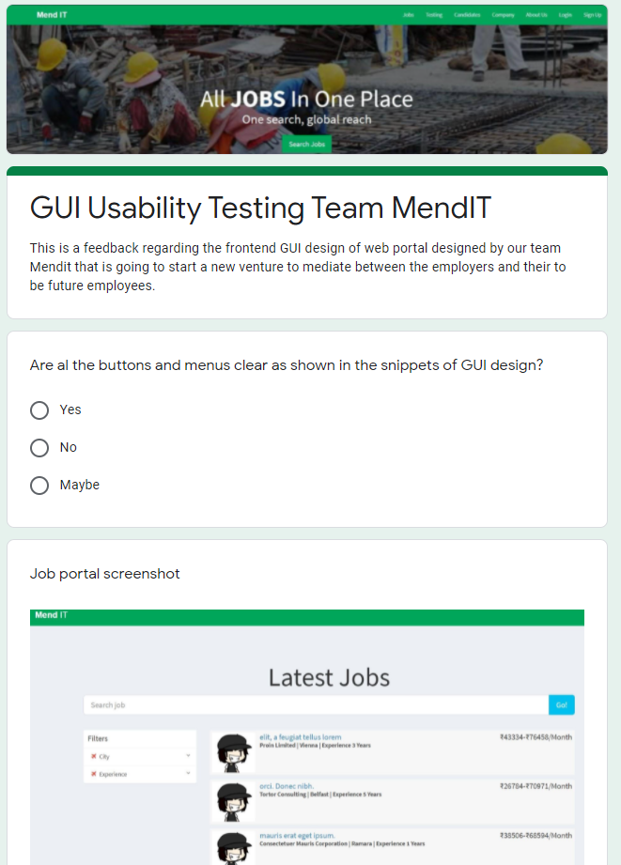
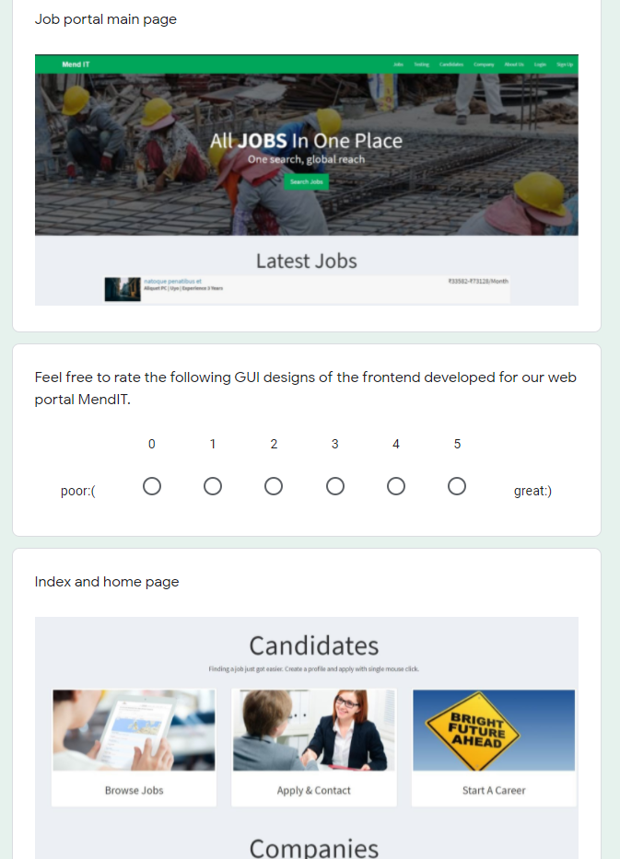
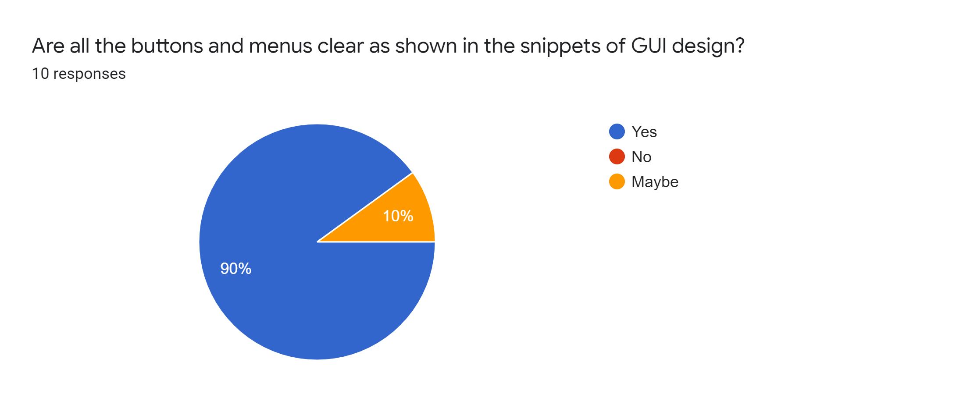
GUI Usability testing survey:

Slide 6
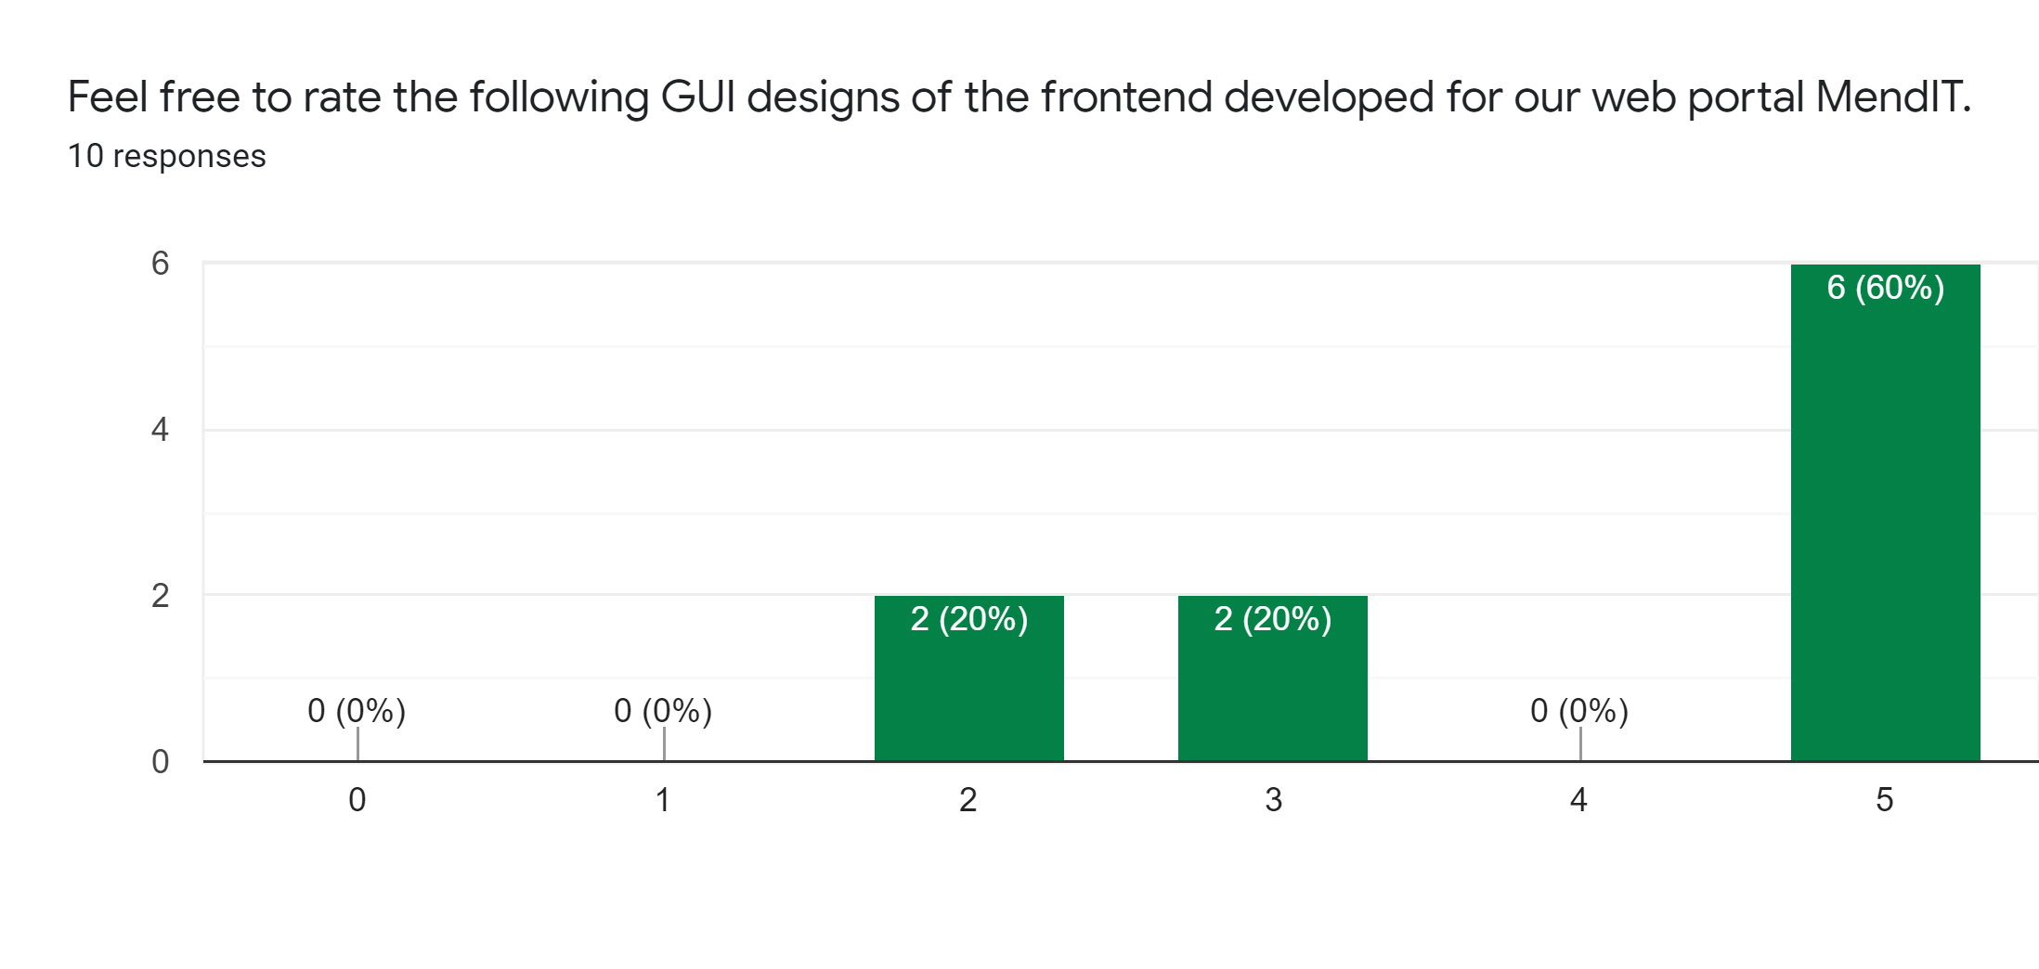
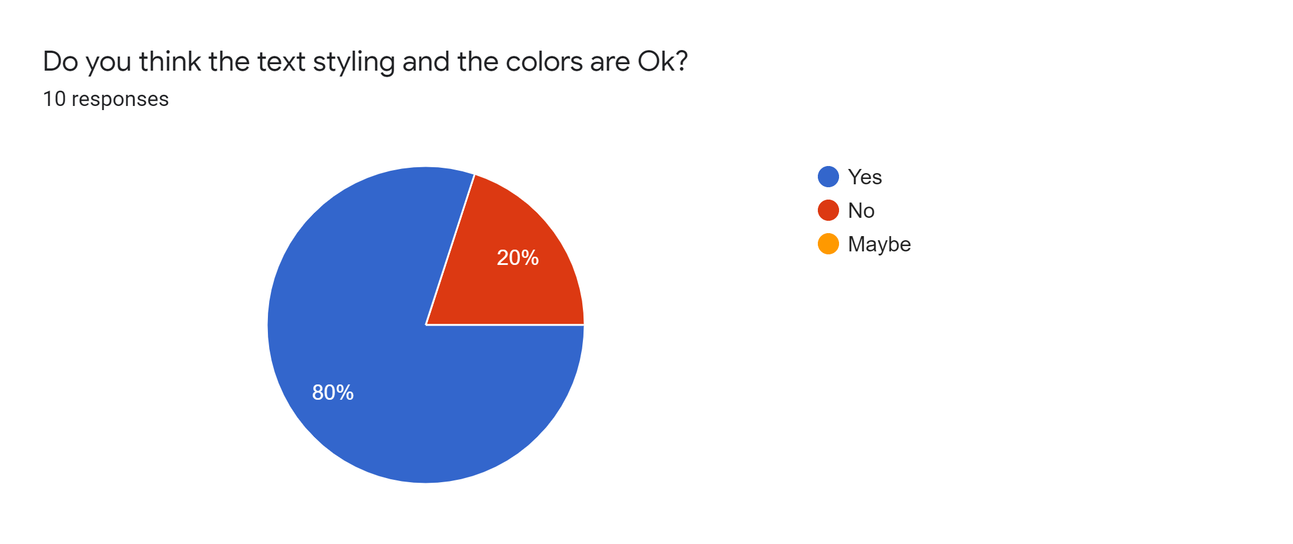
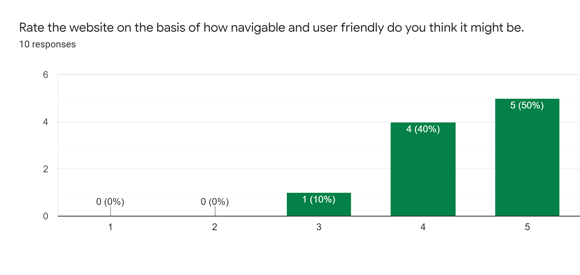
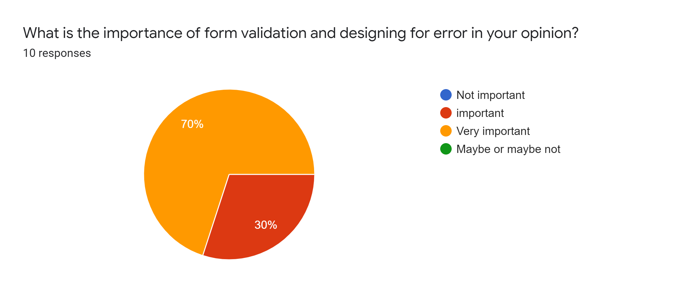

Slide 7
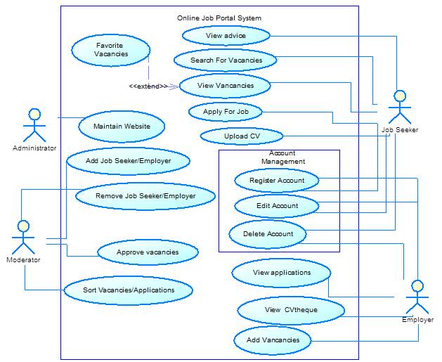
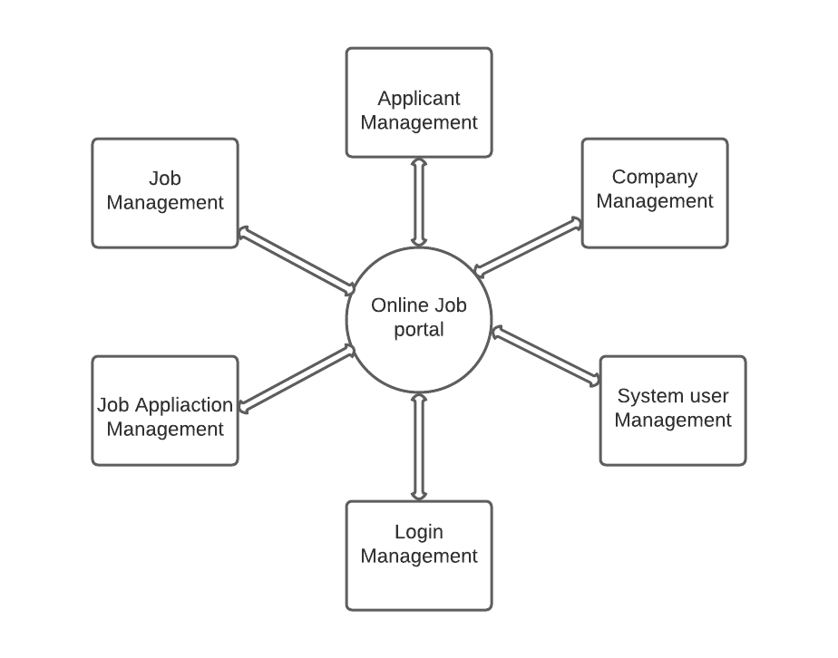
Backend designing and construction:
High level (not so detailed) database schema.

Slide 8
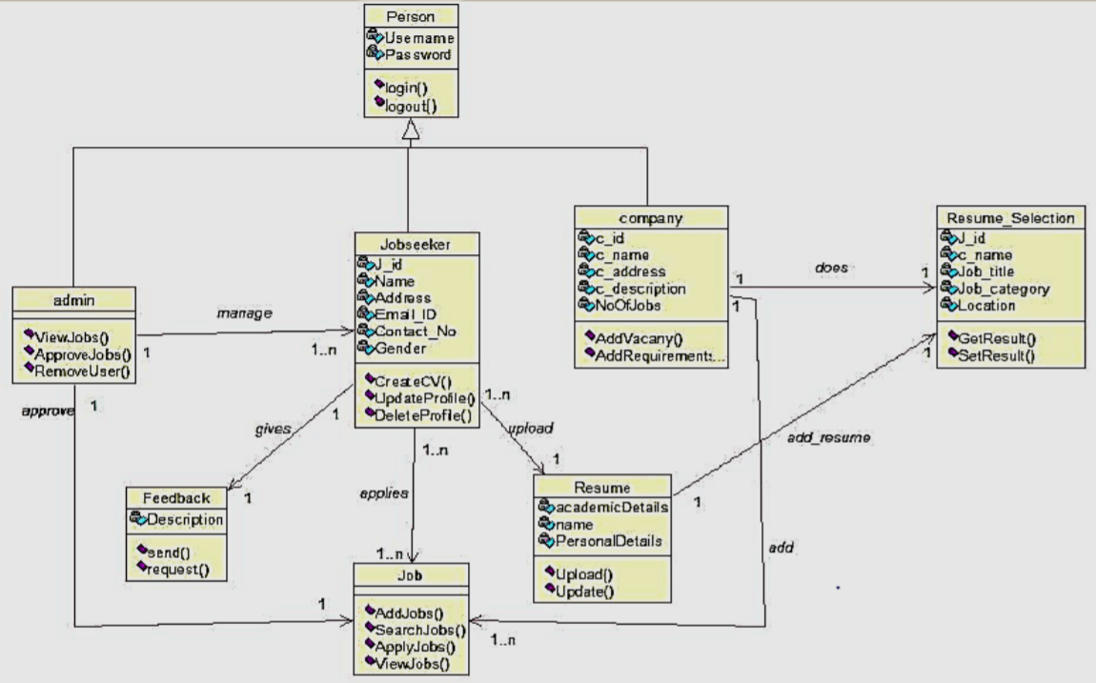
Low level detailed database schema for the project.

Slide 9
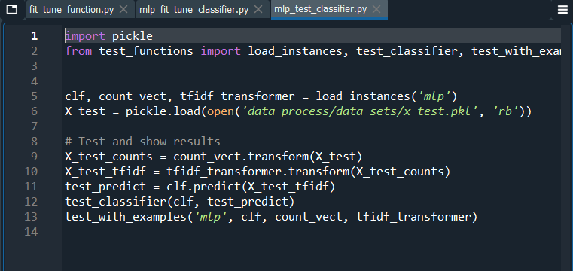
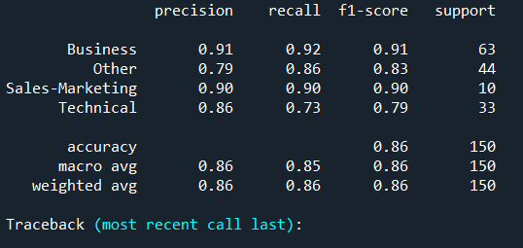
ML algorithm implementation and results:
SGD has better average than MLP. SGD uses SVM model, a good model for text classification. SGD/SVM has an accuracy of 96% and on the other hand MLP has a lesser accuracy of 86%.

Slide 10
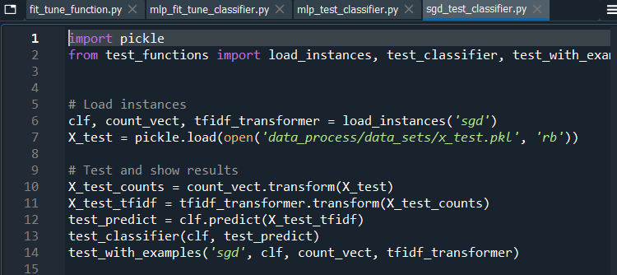
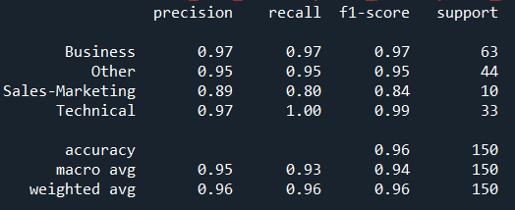
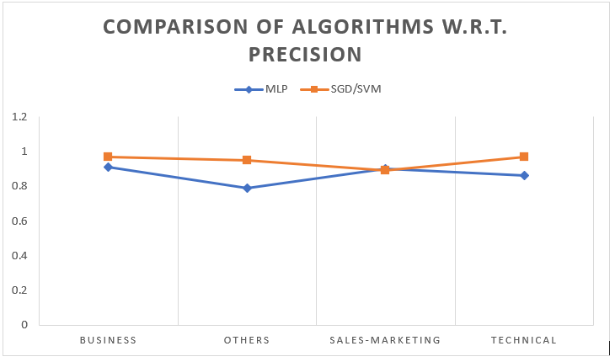
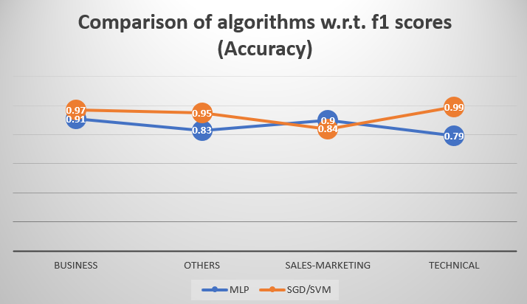

Slide 11
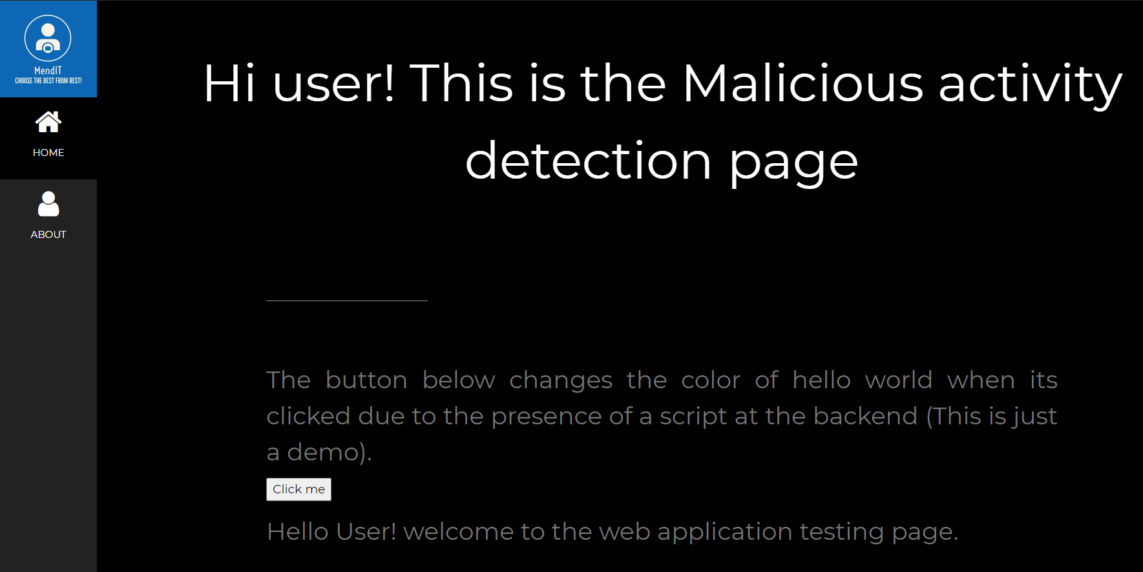
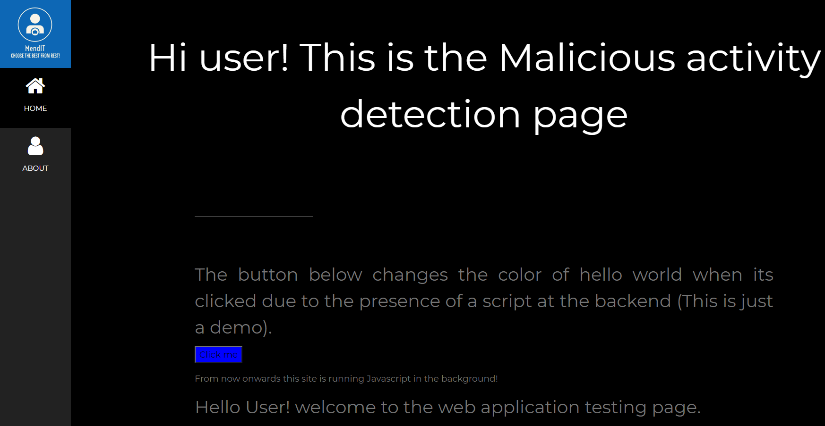
Security feature for website:

Slide 12
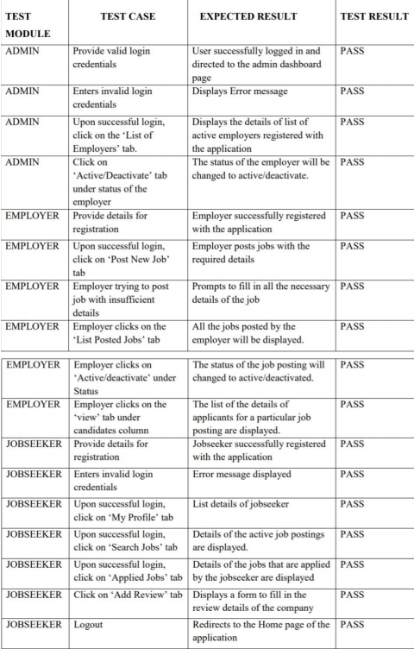
Module testing report:

Slide 14
MOM’s
MOM 8: in the 8 meeting of our group team MendIT held in first week of may we discussed on the proceedings of the frontend development and backend development with the concerned students doing it. We also distributed the work for the next week.
MOM 9: A meeting was held in second week of May on 5 May during vacation to tell each other what was done and what was left. Frontend and backend got completed. ML algorithm was in progress and we decided to conduct a google form survey to get user or client inputs for the GUI frontend design.
MOM 10: Another last meeting was held on 16 May to interpret the client and people responses and frame it into the document. We also discussed the results we got from the Ml algo. Implementation. And further we decided to conduct a usability testing for each module of our project.

